Slide 1

Sprint #8 Presentation
Notes:
Alex

Slide 2


Sprint #8 Goals
Integrate separate search engine to website
Front end designing
API Switch (Edamam to Spoonacular API)
Recommendation Model work
Finish having a presentable product with some functionality
Notes:
Dane

Slide 3
Updates
Business Requirement Document
User Story Update
Product Requirement Document
Updated Sprint Board, Gantt Chart, Burndown Chart, Project Tracker
User Stories
Released user stories this sprint
As a user, I want to be able to explore recipes and pick a recipe to begin cooking right away
Notes:
Dane

Slide 4
User Stories in the final product
As a user, I want to be able to sign up for an account to utilize the application
As a user, I want to be able to login into the system to use features of the application
As a user, I want to be able to explore recipes and pick a recipe to begin cooking right away
As a user, I want to see pictures for the recipe in order to help me decide which recipe to make at a glance
As a user, I want a friendly and visually appealing UI in order to have a nice cooking experience
As a user, I would like no distractions or pop-ups that get in the way of my recipe instructions so that I can have a smooth cooking experience
Final Epics:
Account Creation
Recipe Search
Display Recipe instructions and ingredients
Notes:
Dane

Slide 5
Test Plan
Level of testing: both white box/black box testing
Test Cases Generation Process:
Research of components needed to satisfy each user story
Creation of components
Component testing begins within localhost
Resolve any bugs that occur during testing
If bug cannot be resolved, rework component
Once testing is done, component deployment
Version Control: GitHub
Hosting: Firebase
We believe that we have tested everything to the best of our abilities. This is because our scope is limited to us 5 within the group. Feedback from the users/stakeholders play the most important part in delivering a functional application in terms of feedback.
Notes:
Dane

Slide 6
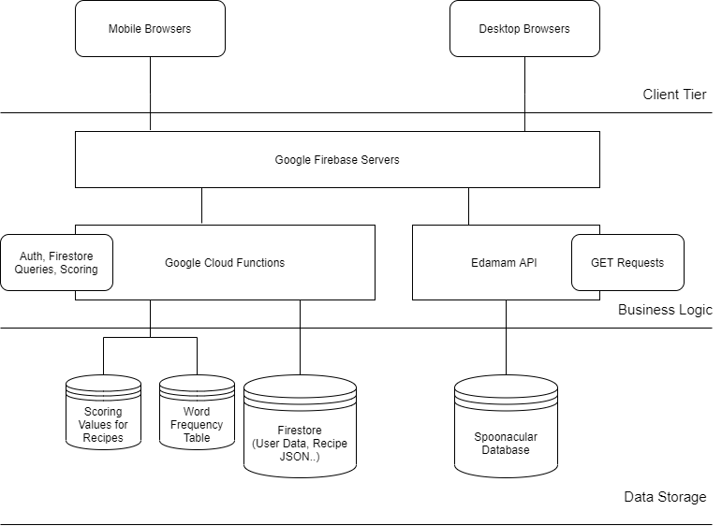

Client-Side Architecture
Spoonacular
Database
Notes:
john

Slide 7
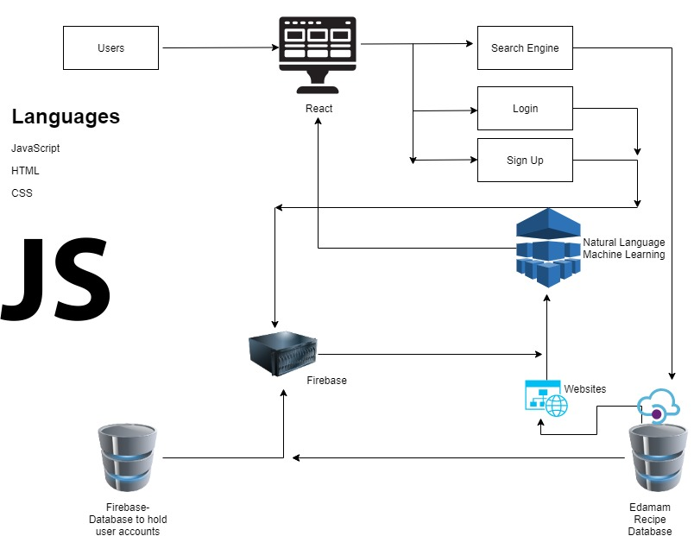


Architecture
React.js used for front-end
1 API - Spoonacular API (3rd Party)
User Platforms:
Chrome Extension
Web application
ODM Library: Firebase Firestore
ODM
Spoonacular API
Notes:
Jose

Slide 8
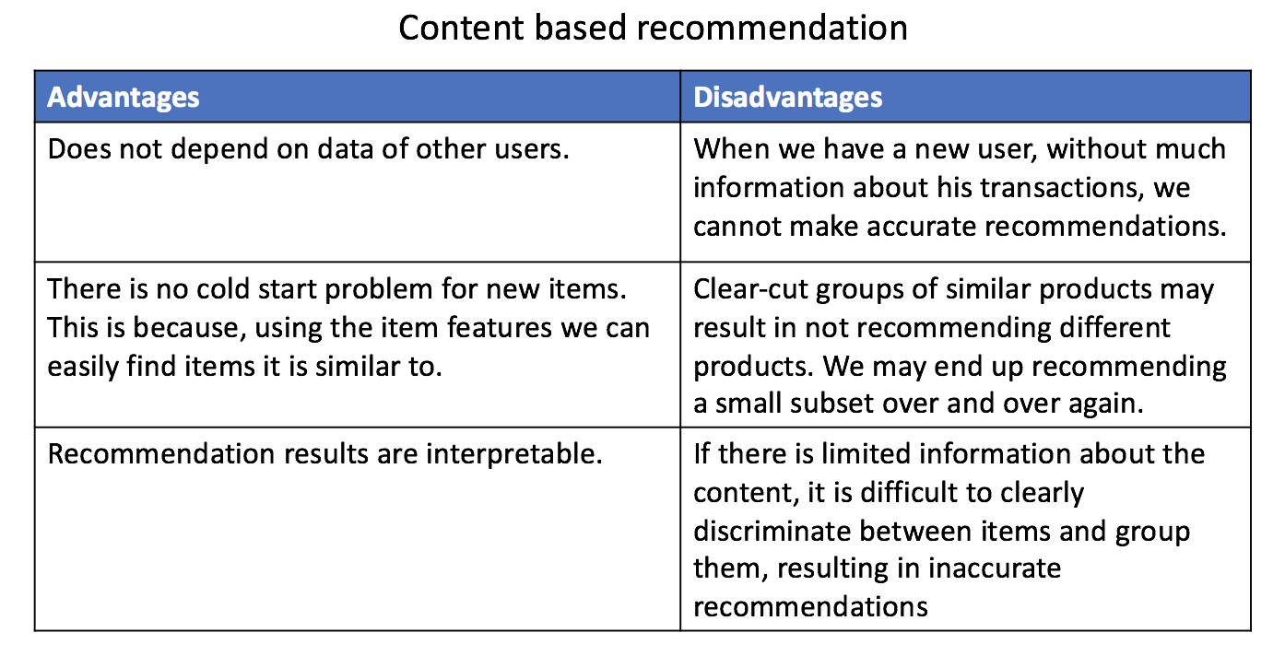
Recommendation Model - Content Based
Notes:
jose

Slide 9
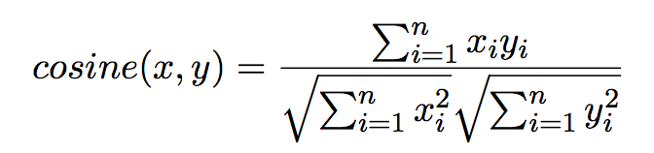
Content Based: Methods to find similarity
Cosine Similarity:
To compute similarity between the user and item, we simply take the cosine similarity between the user vector and the item vector. This gives us user-item similarity. To recommend items that are most similar to the items the user has bought, we compute cosine similarity between the articles the user has read and other articles. The ones that are most similar are recommended. Thus this is item-item similarity.
Notes:
jose

Slide 10
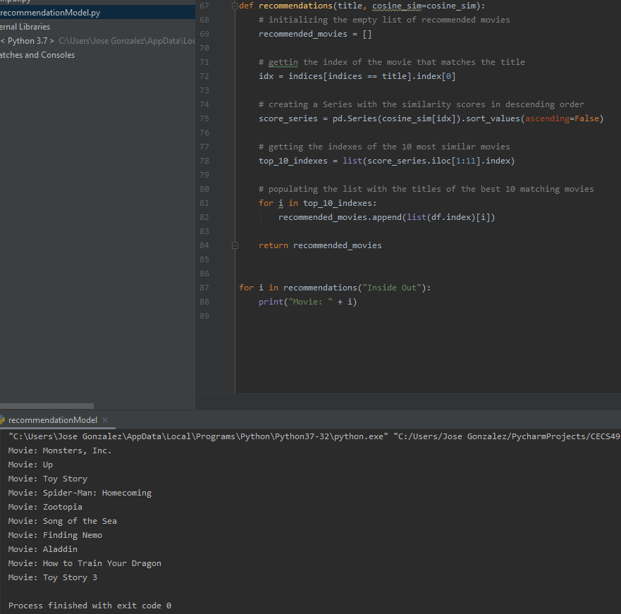
Python Version
- Recommendation Model
Business Case:
X - bag_of_words( plot + keywords)
Y - bag_of_words (movie compared)
Alternatives Models: Decision Tree
Notes:
jose

Slide 11
Breakdown of Prototype

Slide 12
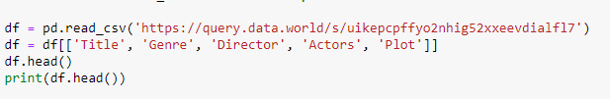
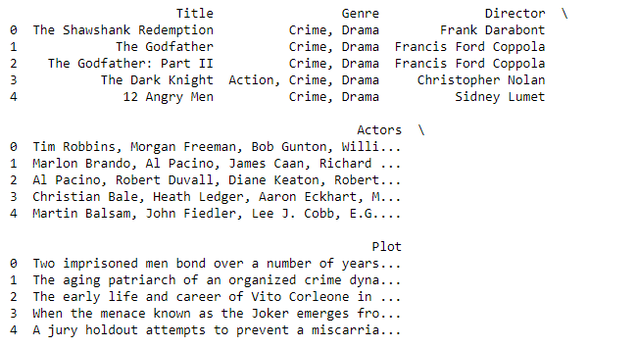
Importing our Dataset
https://query.data.world/s/uikepcpffyo2nhig52xxeevdialfl7

Slide 13
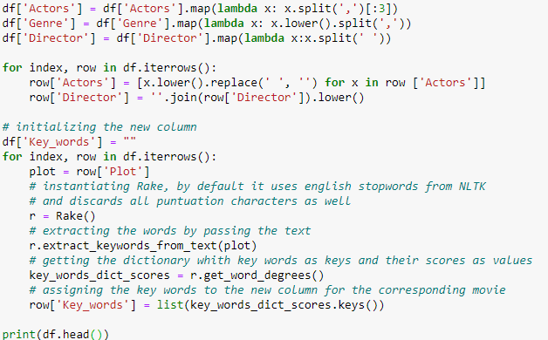
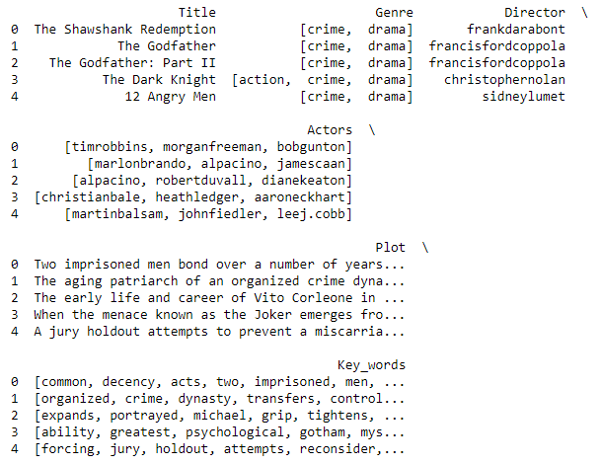
key_words
Director and Actors names are merged
Plot is broken up into key_words. Key_words are scored depending on their frequency in the plot.

Slide 14
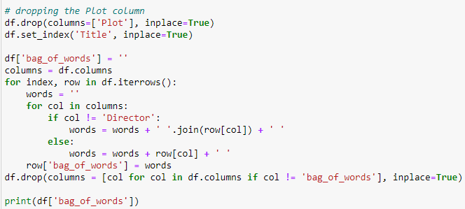
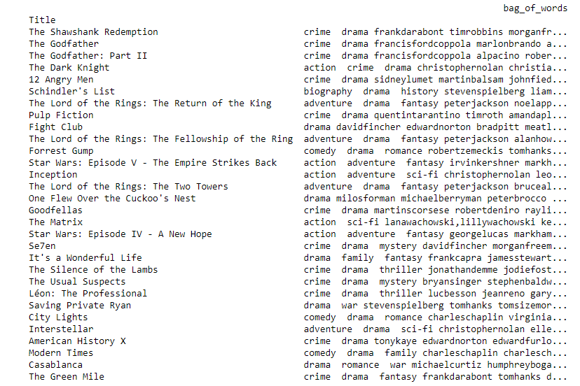
bag_of_words
We drop the plot column and add the column bag_of_words
Plot, Actor/Director Names, and genre are in this array

Slide 15
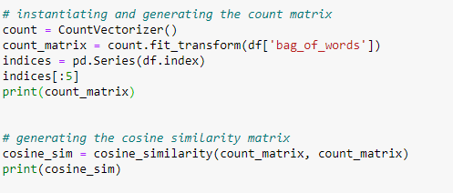
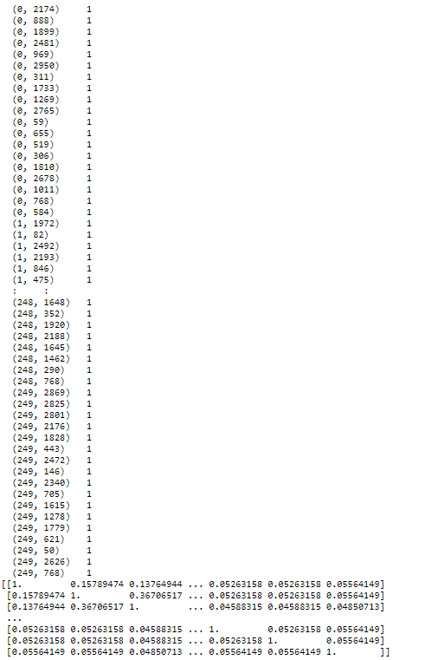
Count_matrix is generated by using the CountVectorization on the bag_of_words
CountVectorization.fit_transform generates: Learns the vocabulary dictionary and returns term-document matrix.
We pass the count_matrix to our cosine_similarity function

Slide 16
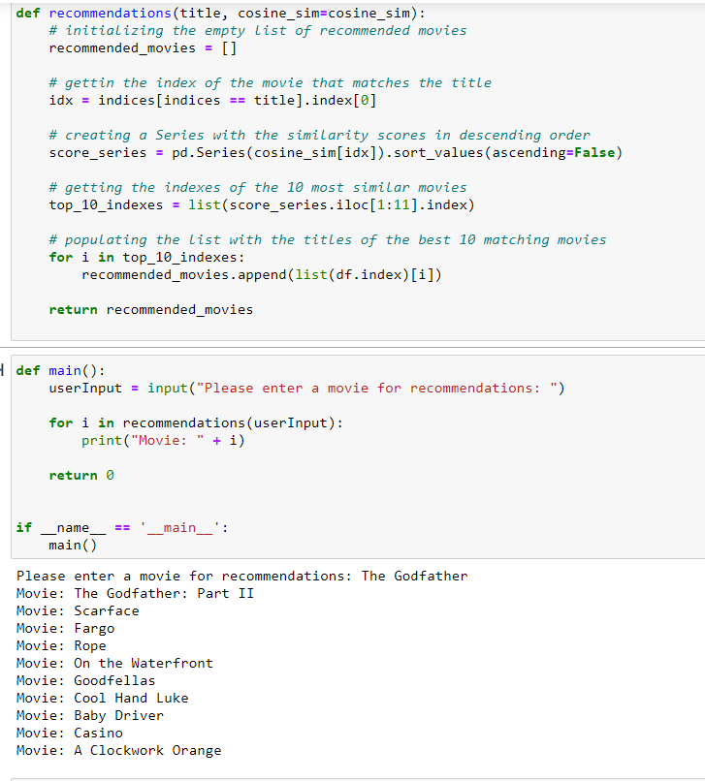
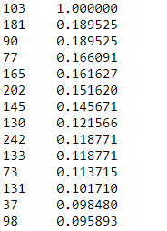
Overall Function

Slide 17
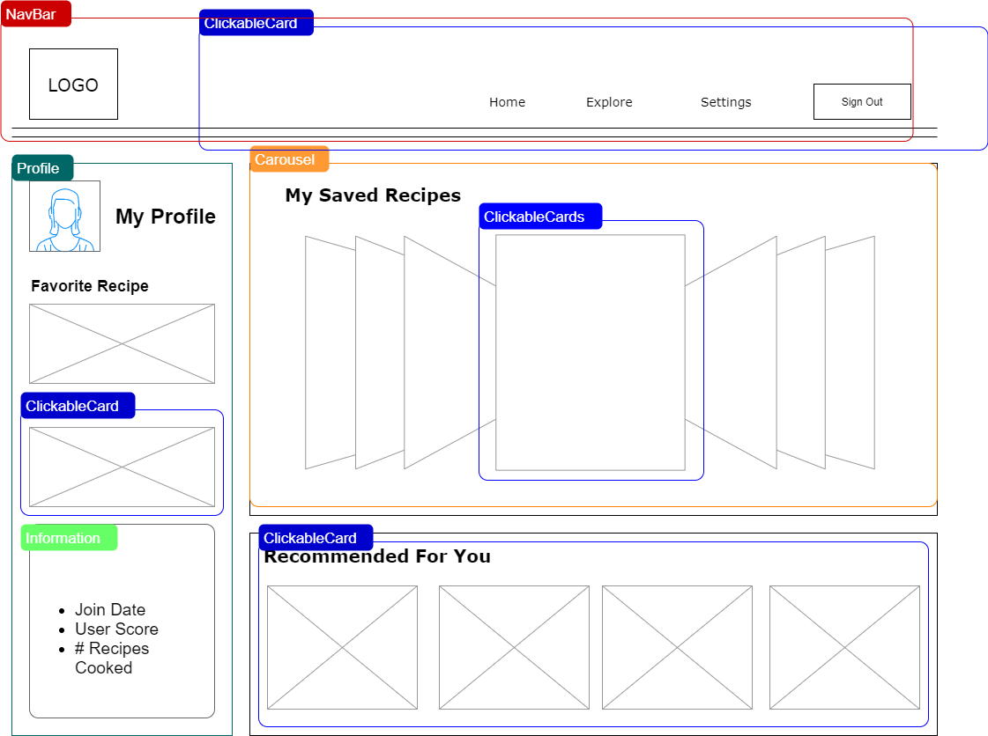
Front End Design: Home Dashboard
Notes:
john

Slide 18
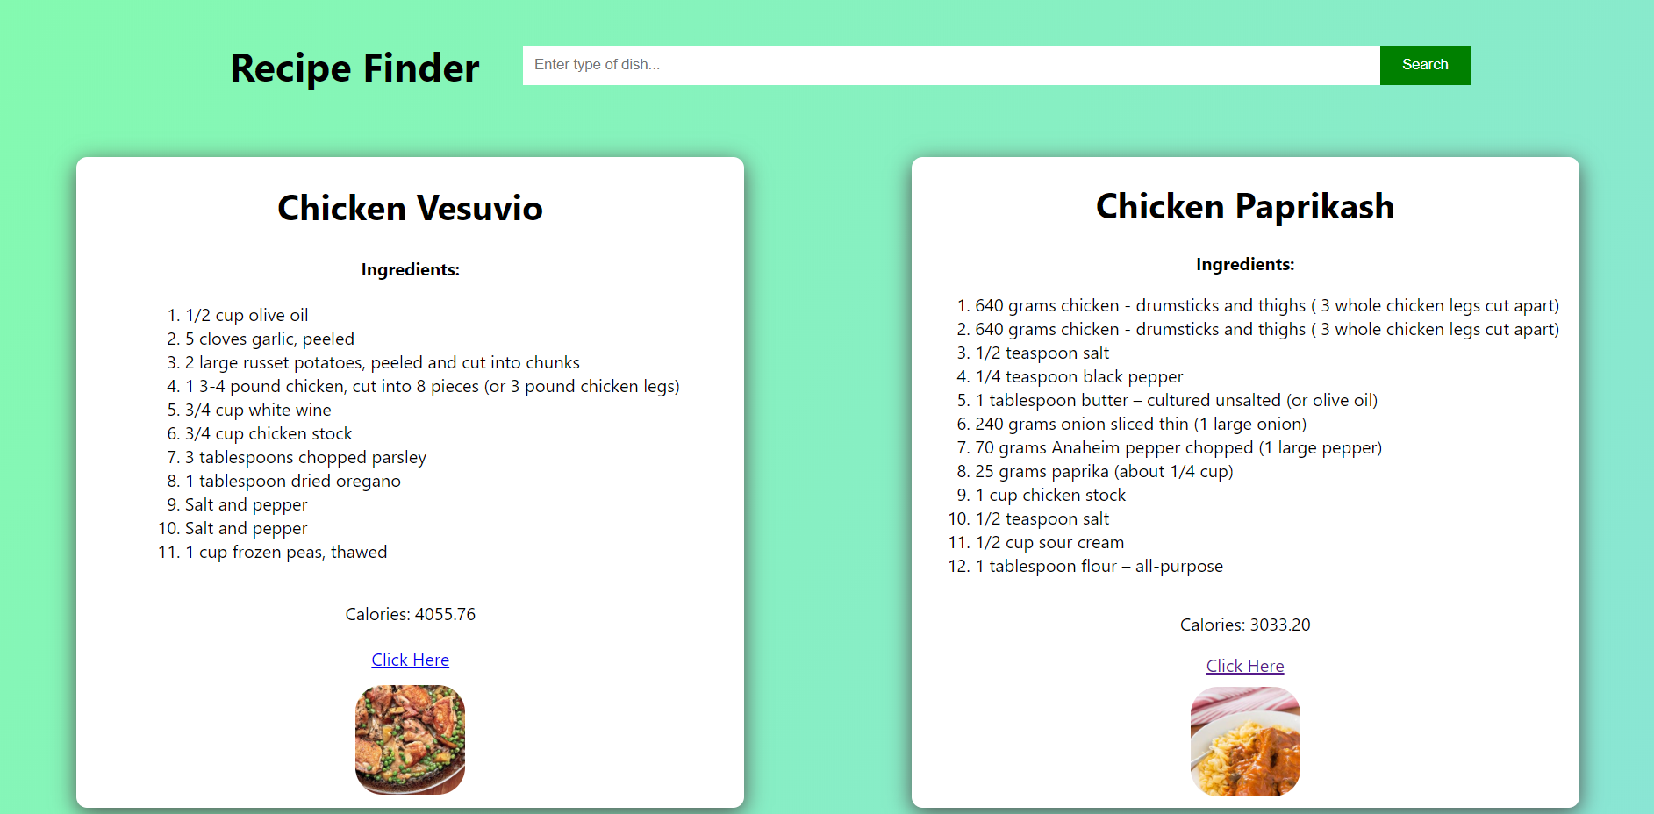
Recipe Explore tab UI
Notes:
john

Slide 19
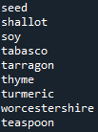
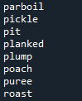

Recipe Finder
High tier
refrigerate 34
ingredients 84
boil 123
Medium tier
tea 89
tablespoons 47
kosher 3
Low tier
temperature 37
dinner 3
paste 20
What even is this?
cannedif 1
135140f 1
High tier
Cooking Verb
Medium tier
Cooking Noun
Low tier
Any other word that appear in our vocabulary list
Notes:
alex

Slide 20
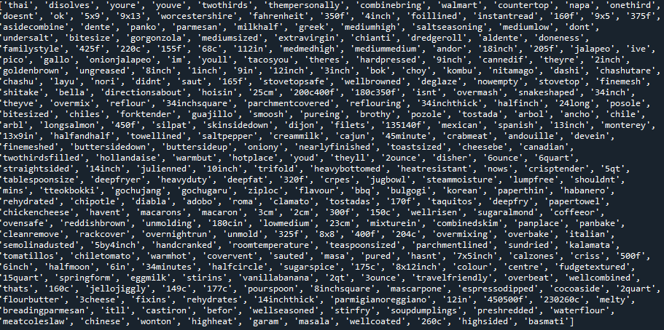
Recipe Finder
Removed all non-english words
Removed words that occur less than 2 times
Removed article words, pronouns
Went through the data, line by line, and took out data that we did not like
Notes:
alex

Slide 21
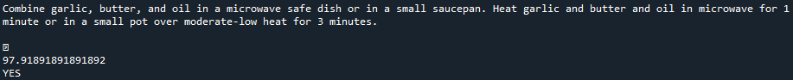
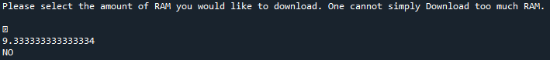
Recipe Finder
First implementation of a scorer / recipe finder
Still a work in progress
Only able to tell the difference from COOKING SENTENCE and a sentence of another topic.
"Combine garlic, butter, and oil in a microwave safe dish or in a small saucepan. Heat garlic and butter and oil in microwave for 1 minute or in a small pot over moderate-low heat for 3 minutes."
“Please select the amount of RAM you would like to download. One cannot simply Download too much RAM.”
Notes:
alex

Slide 22
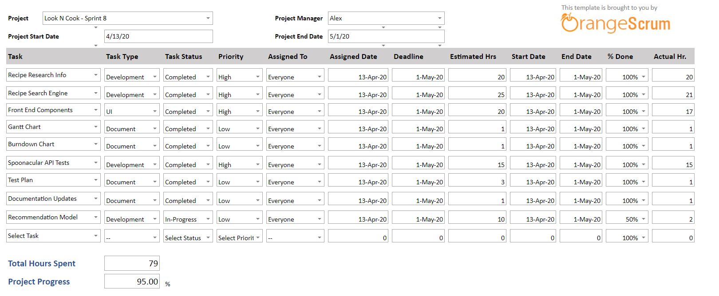
Project Tracker
Notes:
henry

Slide 23
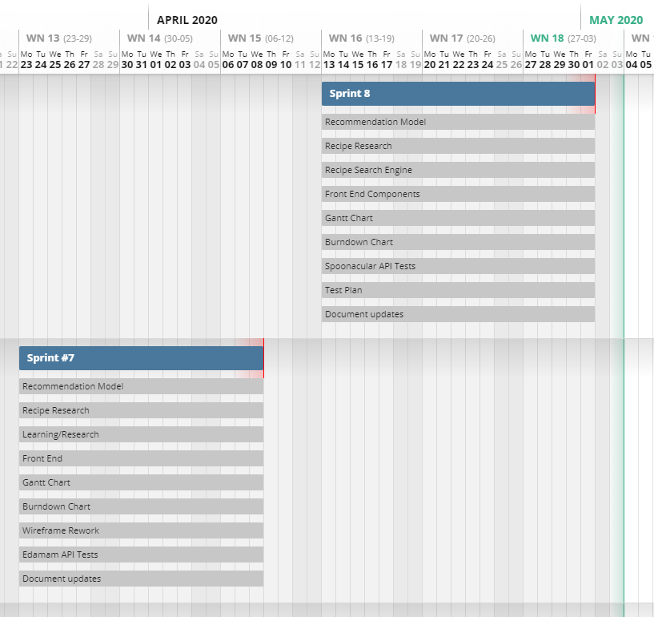
Gantt Chart
Notes:
henry

Slide 24
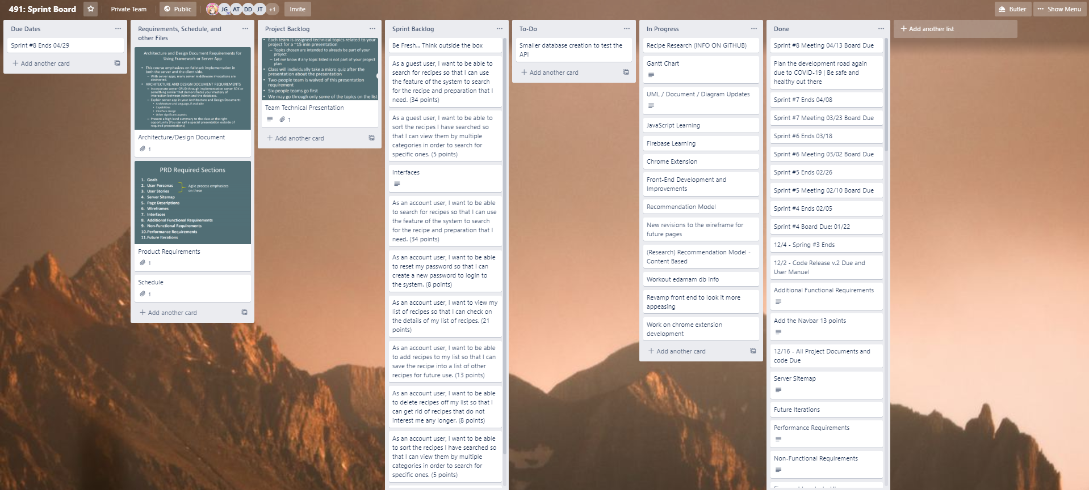
Sprint Board-Before
Notes:
henry

Slide 25
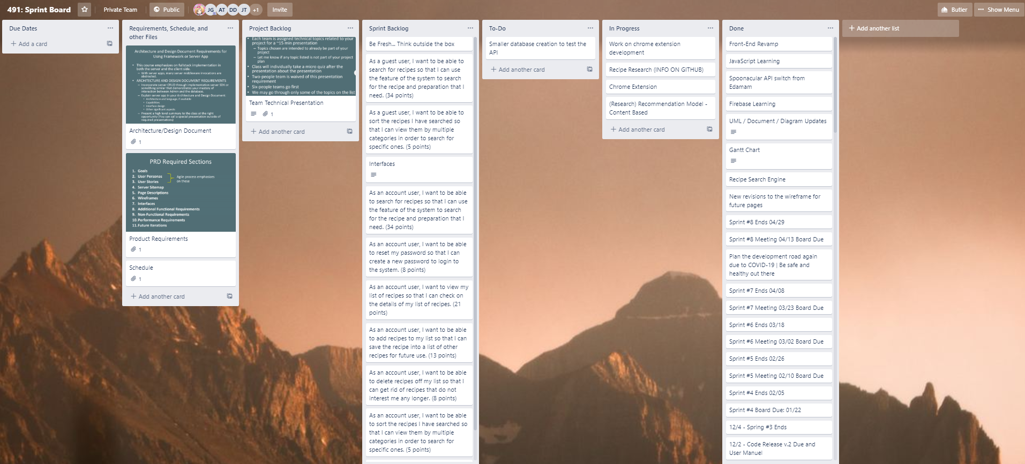
Sprint Board-After
Notes:
henry

Slide 26
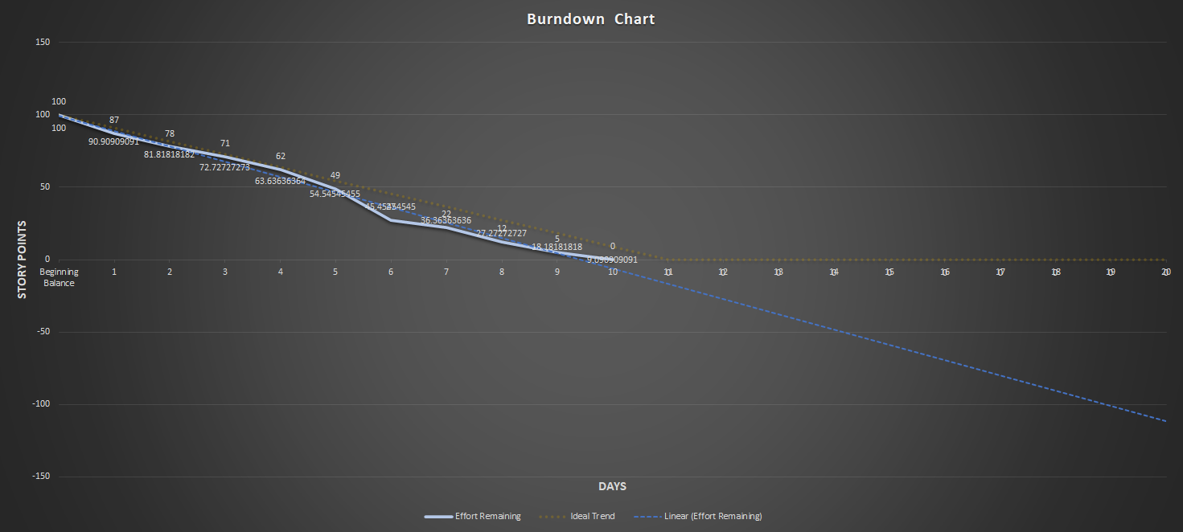
Burndown Curve
Notes:
Jose

Slide 27
Sprint Retrospective
What caused problems?
The time and pressure needed to complete the project
Conclusions
Our desired features are implemented
Incomplete recommendation system/machine learning aspect
Did we meet our Sprint Goal?
Mostly; We finished the features that were desired. The only incomplete feature would be the recommendation system.
What worked well/Didn’t work well?
Search Engine functionality is working
Front end components finished
Recommendation system is not complete unfortunately
Priority of User Stories: Main functionalities of the website first before machine learning aspects
User story points planned: 25
User story points achieved: 22
In progress:
1 - Recommendation System
Notes:
Dane

Slide 28
Demo

